Slide 1
Team 55: National Firefighter Registry
In Collaboration with CDC-NIOSH
09/20/2020

Slide 2
Presentation Link
https://youtu.be/v2Z4LHAFDTk

Slide 3
Team 55: Personnel
Team 55 Members:
James Davis
Haolong Yan
Rahul Nowlakha
Joe Kurokawa
Traver Clifford
Michael Rojas
CDC Mentors:
Jill Raudabaugh
Breanna Newton
GT Mentor:
Elizabeth Shivers

Slide 4
Agenda
Motivation Behind the National Firefighter Registry
Scope of National Firefighter Registry
Our Role
Solution Architecture
Project Plan

Slide 5
Why create the National Firefighter Registry?
Firefighters at higher risk for various cancers, respiratory conditions, etc.
Limited information on long-term health of firefighters
Need for long-term medical information and inclusion of women and minorities
Creation spurred by passing of Firefighter Cancer Registry Act of 2018
Notes:
References:
Health risks: https://www.cdc.gov/niosh/firefighters/health.html

Slide 6
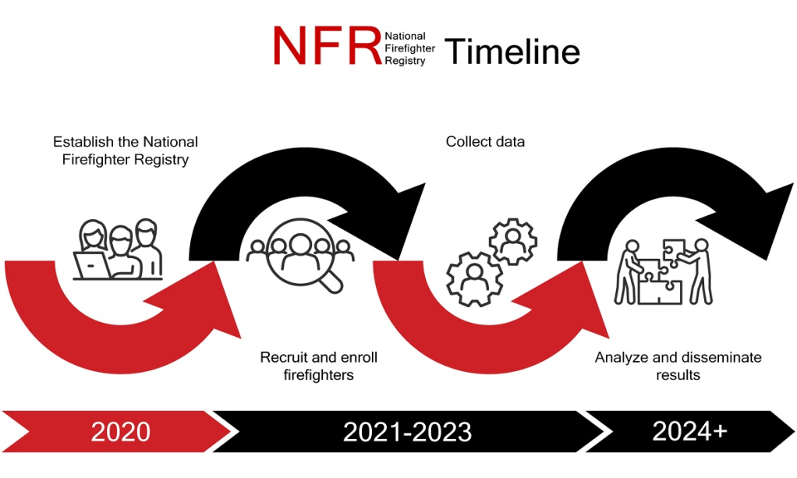
National Firefighter Registry
CDC project to track health information of firefighters to analyze cancer trends
Enrollment is on a volunteer basis
Goal is >200,000 firefighters enrolled
Source: https://www.cdc.gov/niosh/firefighters/registry.html

Slide 7
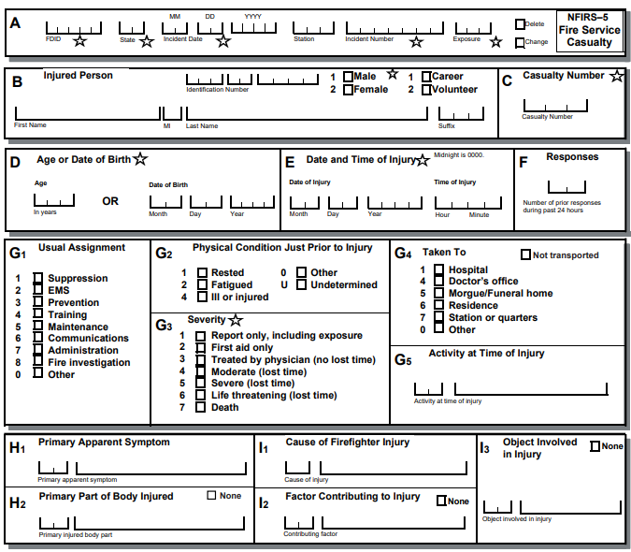
Our Role
Existing NFIRS casualty form not FHIR compatible
Goal: Accept JSON/XML FHIR resources, validate, and insert into SQL database
Add visualization capabilities
Source: NFIRS Reference Guide (2015) pp. 182

Slide 8
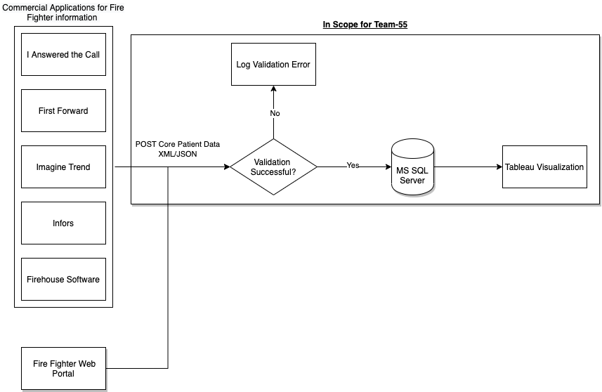
Solution Architecture

Slide 9
Project Plan

